Slide 1
Casper Protocol
ETHEREUM

Slide 2
Presentation Index
How does Ethereum works?
PoW vs PoS
What is Casper?
Validators
Problems

Slide 3
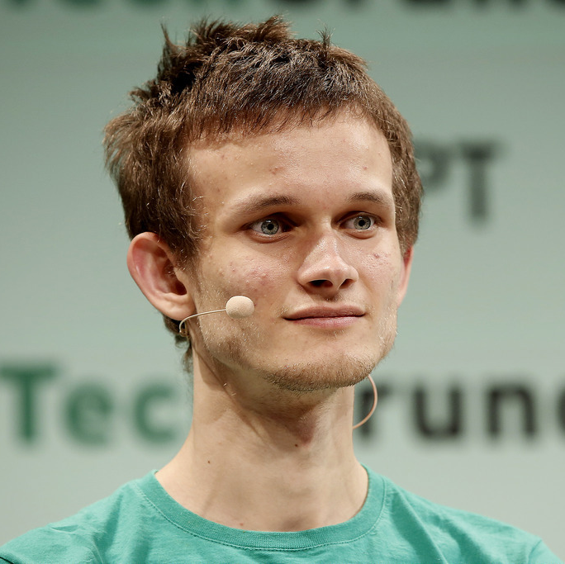
Vitalik Buterin
Founder – Inventor, Ethereum
Ethereum is a decentralized platform that runs smart contracts: applications that run exactly as programmed without any possibility of downtime, censorship, fraud or third-party interference.

Slide 4
Because decentralized applications run on the blockchain, they benefit from all of its properties:
Immutability
Corruption & tamper proof
Secure
Zero downtime

Slide 5
Proof of Work
PoS
vs
Proof of Stake
PoW

Slide 6
The Proof of Work
Proof of Work
PoW
PoS
PoW/PoS
Mining
Stakes
Hibrid

Slide 7
Problems:
Expensive
ASICs, GPUs, CPUs are very expensive and not everyone can afford them. Even when you make a investment, these kind of hardware will be old soon.
Expensive
Centralized
Centralized
Bitmain, the biggest company about producing of mining hardware, has more than 51% of all Bitcoin’s hashrate.
01
02
Dangerous
Energy Usage
Dangerous
Having a centralized system means be vulnerable to a 51% attack which will cause lots of problem in a network.
03
04
Energy Usage
Just the Bitcoin mining consume the annual energy consumption of Ireland.

Slide 8
The Proof of Stake
Proof of Work
PoW
PoS
PoW/PoS
Mining
Stakes
Hibrid

Slide 9
Energy efficient
No mining required.
01
Smaller costs
Smaller incentives are needed to keep the network going, due to smaller costs of mining new blocks (both energy-wise and hardware-wise)
The rich get richer
Rewards from the network (generally) will go only to those who already have a high amount of capital
05
02
04
03
Dishonest? Lose you stake
With 51% attack you are not losing hardware o coins. In a PoS protocol you will lose your stakes.
Less complexity
Generally reduces complexity of mechanisms needed to regulate the network, like difficulty adjustments.

Slide 10
Hybrid PoW/PoS
Proof of Work
PoW
PoS
PoW/PoS
Mining
Stakes
Hibrid

Slide 11
Hcash
Hcash is a decentralized and open-source cross platform cryptocurrency, exchange value and data cross platform easily and based on a highly secure and authenticated channel.

Slide 12
PoW vs PoS Adoption

Slide 13
Casper’s rules
02
CASPER
Violation & frauds
Validators
01
03
One Chain
Check points
05
04

Slide 14
Casper
Casper (PoS)
Final version of Casper. Will be implemented after the FFG version.
Casper FFG (Pow/PoS)
Hybrid version of Casper. It helps in switching from Proof of Work to Proof of Stake.
Timeline not ready yet
Perhaps 2019

Slide 15
r

Slide 16
Block 1
1
Simple Block. h(1)=1
2
Block 2
Simple Block. h(2)=2
Block 3
3
Simple Block. h(3)=3
4
Block 4
4.1
Checkpoint. h(4)=4
..
“Follow the chain containing the justified checkpoint of the greatest height.”
..
..
..

Slide 17
Block 1
1
Block 1
1
Block 1
1
Simple Block. h(1)=1
Simple Block. h(1)=1
Simple Block. h(1)=1
2
Block 2
2
Block 2
2
Block 2
Simple Block. h(2)=2
Simple Block. h(2)=2
Simple Block. h(2)=2
Block 3
3
Block 3
3
Block 3
3
Simple Block. h(3)=3
Simple Block. h(3)=3
Simple Block. h(3)=3
4
Block 4
4
Block 4
4
Block 4
4.1
4.1
4.1
Checkpoint. h(4)=4
Checkpoint. h(4)=4
Checkpoint. h(4)=4
..
..
..
..
..
..
..
..
..
..
..
..

Slide 18
Block 1
1
Simple Block. h(1)=1
2
Block 2
Simple Block. h(2)=2
Block 3
3
Simple Block. h(3)=3
4.1
a
Block 4
Checkpoint. h(4)=4
..
..
..
b

Slide 19
s
..
Conflicting
Two checkpoints a and b are called conflicting if and only if they are nodes in distinct branches, neither is an ancestor or descendant of the other.
..
..
..
..
a
b

Slide 20
1
2
3
Justified
c’
A checkpoint c is called justified if it's the root, or there exists a supermajority link c’→ c where c’ is justified.
..
c
..
..

Slide 21
1
2
..
Finalized
..
A checkpoint c is called finalized if it is justified and there is a supermajority link c → c’ where c’ is a direct child of c.
c
..
c’
..

Slide 22
Vote mechanism for Checkpoints
Checkpoint finalized (or not)
If all requirments are met, the checkpoint is finalized.
04
Expressing a vote
Every node expresses a vote, positive or negative, and share it with everyone else.
03
Validator proposal
The choosed Validator make a proposal according to all the requirments.
02
Choosing a Validator
With a Round-Robin mechanism a Validator will be choosen in order to propose a Block as Checkpoint.
01

Slide 23
Choosing a Validator
01
02
02
Choosed node
Validators
Chosen by using the Round-Robin algorithm
06
03
05
04

Slide 24
Validator proposal
sig
s
h(s)
h(t)
Signature from the Validator’s private key
t
The height of checkpoint s
The hash of any justified checkpoint.
The source ”S”
The height of block t
The hash of the block
Target ”T”

Slide 25
Expressing a Vote
Node N+5
Node N+4
Node N+6
Node N
Node N+3
Node N+1
Node N+2

Slide 26
Finalizing Checkpoint
02
One vote each
An individual validator V must not publish two distinct votes.
Accountable Safety
Two distinct checkpoint a and b cannot be both finalized.
C
01
03
Losing deposit
Breaking rule means lose deposit (entirely or partially).
Plausible Liveness
Supermajority links can always be added to produce new finalized checkpoints,provided there exist children extending the finalized chain.
04

Slide 27
Dynamic Validator Sets
Join
Stay
Leave
01
02
03
News Validators must be able to join
Keep working on the network
A Validator can leave under few conditions

Slide 28
Request: d(B) = 3
d(B) = 2
Join: d(B)=5
DS(v)=5
DE(v)= ∞
..
..
..
..
..
..
Dynasty
The dynasty d of a block B is the number of finalized checkpoints in the chain from root to the parent of block B.

Slide 29
Request: d(B) = 21
DE(v) = 23
..
..
..
..
..
..

Slide 30
Casper problems
51% Attack
Still available, but it will probably fixed in future.
Catastrophic Crashes
More then 1/3 of all Validators crash at the same time.
Dynamic Validators Set
Right information, wrong block.
A peep at some distant orb has power to raise and purify our thoughts like a strain of sacred music.

Slide 31
Casper Protocol
Stefano Cavalli – Sistemi di elaborazione – Università degli Studi di Parma Casper The Friendly Finality Gadget – Vitalik Buterin / Virgil Griffith – Ethereum Foundation

